Slide 1
SUG Montréal
Starting soon…

Slide 2
Continuous Improvement for DevOps
Jason St-Cyr
Technical Evangelist @ Sitecore
Notes:
Is our DevOps journey done? Can we do better?
Salut tout le monde! Merci beaucoup pour m’inviter ici ce soir, et je vous demande pardon en avance. Mon francais c’est pas mal terrible. So I’ll be presenting tonight in English. And we’re going to talk about how you can invest in the right DevOps practices and get better.
The reason we’re talking about this today is because I realize… [click]

Slide 3
You probably aren’t “doing it right”
And that is just fine.

Slide 4
This sucks.
We can do better.

Slide 5

Continuous Everything
Notes:
The Art of Repetition
Repeatable processes
Predictable delivery == $$$!!
We aren’t just guessing, we know how to do this.
Again.
And again.
And again.
Need to be deliberate about improvement and delivery.
Start small. Get better. Then do it again!

Slide 6
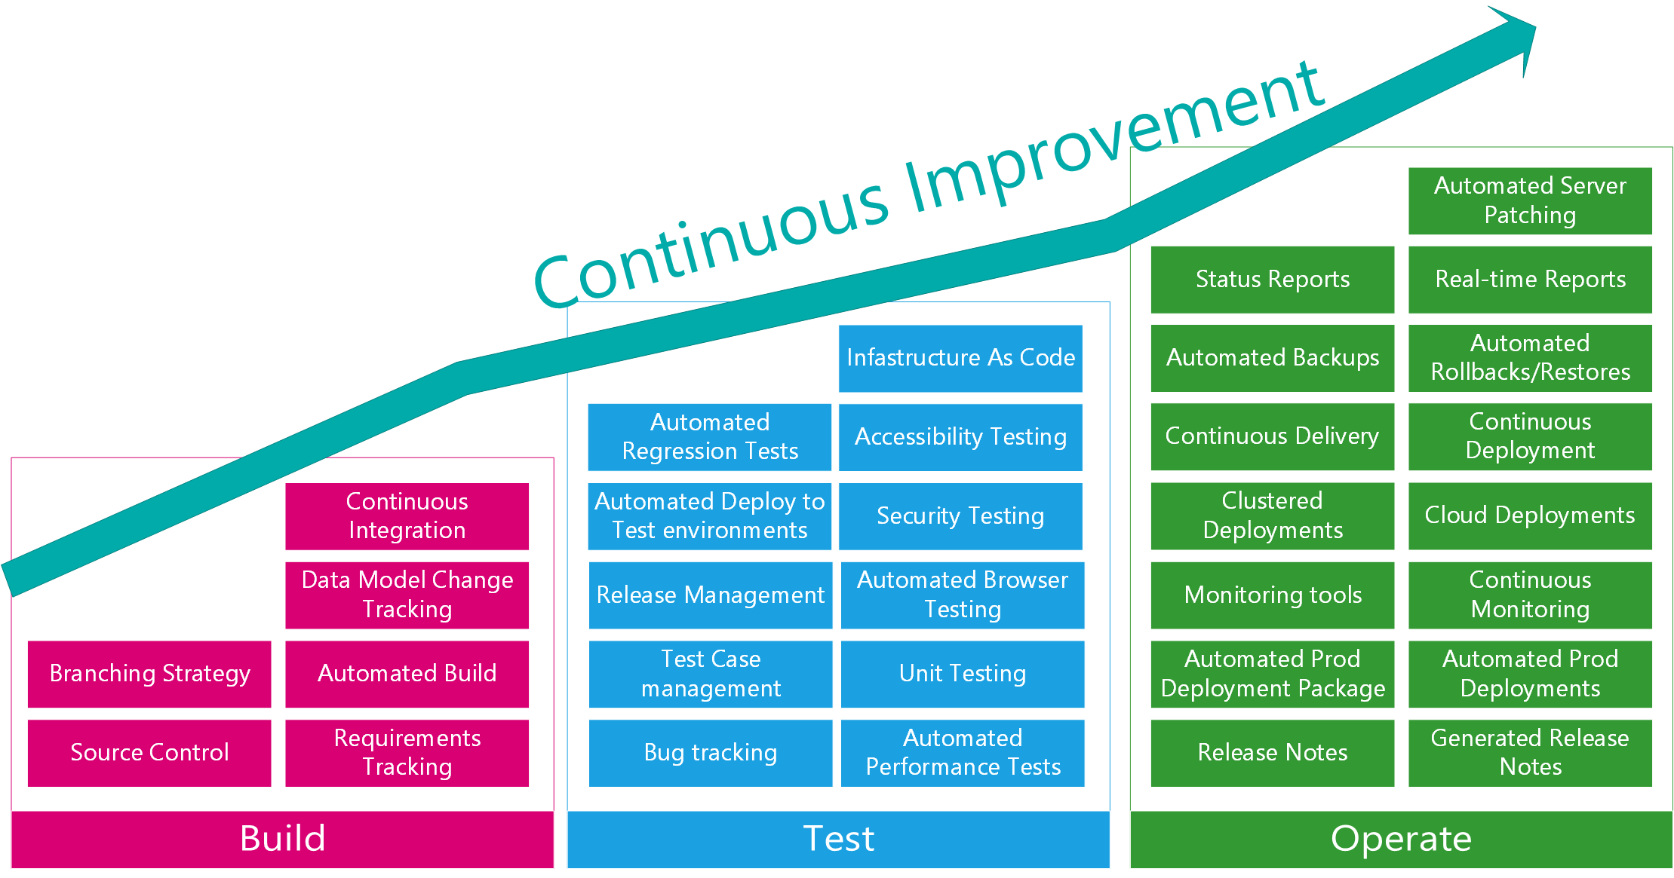
DevOps Maturity Model
Notes:
A few years ago… (history of the maturity model)
Things change but in general DevOps falls into Build, Test, and Operate
First talking about Continuous Integration, then automated testing, now operations and deploying to production
The whole industry is getting better.
How do we do this?
Be better than you were yesterday.
Question everything you are doing.
Look for ways to optimize.
Improve processes and tools.
ALWAYS MINIMIZE WASTE !!
How do we make our lives easier?

Slide 7
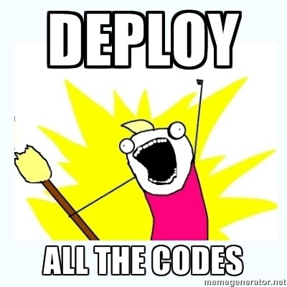
Continuous: Integration
Notes:
This is where we have the most valuable return on investment in the Sitecore context.
Ensure everything is in a deployable state.
- Database and code
“Works on my machine”.
Not good enough.
Database and code
Sitecore solution architecture includes templates, layouts, workflow, security, etc.
Just like two classes referencing each other
Razor CSHTML rendering binds to fields on a template and rendering definition in database.
Need to put it out together.
Culture
“You broke it, you fix it”

Slide 8
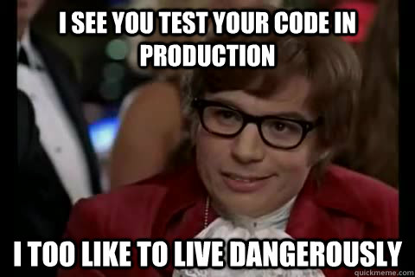
Continuous: Testing
Notes:
“Throw it over the wall and hope”
Not good enough!
Need early feedback
Multiple options:
Testers embedded in the team
- Short feedback loop
- Testers know when things change
Unit Tests
- Easy tooling, devs can do it
- Not all devs are great testers
Automated regression testing
- Not running at a functional level, usually against the interface
- Great for upgrades
- DISADVANTAGE: Automating Sitecore editing interface testing can take more investment
- ADVANTAGE: Sitecore is not unit testable in a lot of places, Selenium testing can work well. Great value.
- Balance regression with unit tests
Business UAT throughout delivery
- Not easy to do, very busy, hard to get involved
- High degree of quality feedback.

Slide 9

Continuous: Delivery
Repeat! Again. And again. But it must be sustainable.
Notes:
Get your money’s worth!
Short cycle between ‘Needing’ and ‘Having’
Get investment into production.
Accept smaller packages of ‘good enough’ (a.k.a. M.V.P)
Choose a sustainable cycle that works for your team.
Involve everyone!

Slide 10
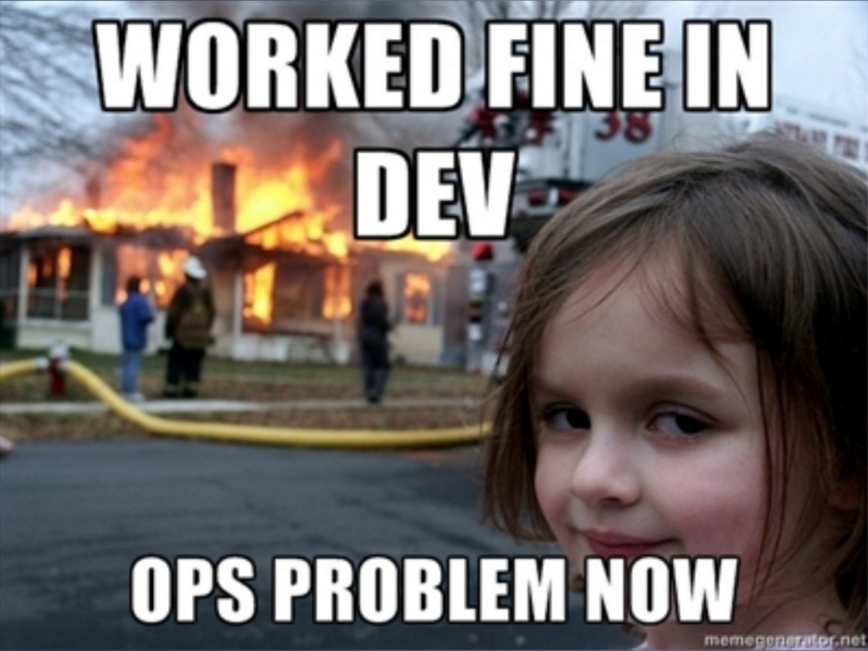
Continuous: Operations
Notes:
What would DevOps be without Operations?
One of the pieces of DevOps is to break down the walls between Development and Operations and make sure we build repeatable processes for deploying and maintaining all our environments.
The Business wants new features from Development, but continuous stability and availability from Operations.
This is one aspect of it, but operations is about more than just pushing code to prod.
Do you know if your site is down right now?
Are you able to monitor if your visitors have stopped being able to purchase products in your checkout process?
Are you able to provide continuous uptime, even during deployments?
These are the questions an Operations expert worries about.
We need tools and processes for this. Some of the advancements with Sitecore on Azure PaaS with Application Insights and other enhancements are improving our ability to have this operational ability.

Slide 11
DevOps Maturity Model
Notes:
Let’s bring ourselves back to our Maturity Model.
A lot more in operations, a lot of places to invest.
Don’t just do Build, then Test, then Operate.
Pick the elements from each where you get the most value.

Slide 12
Coming to Symposium?
Come say hello!
Wednesday, October 18th, 11:15am
Effective DevOps for Sitecore
  Jason St-Cyr, moderator
  Derek Hunziker, Hedgehog
  Kam Figy, ConnectiveDx
  Joe Bissol, Comcast

Slide 13
This sucks.
We can do better.

