Slide 1
We’re about to start…

Slide 2
Advance ALM and DevOps practices with Continuous Improvement
Evolving DevOps

Slide 3
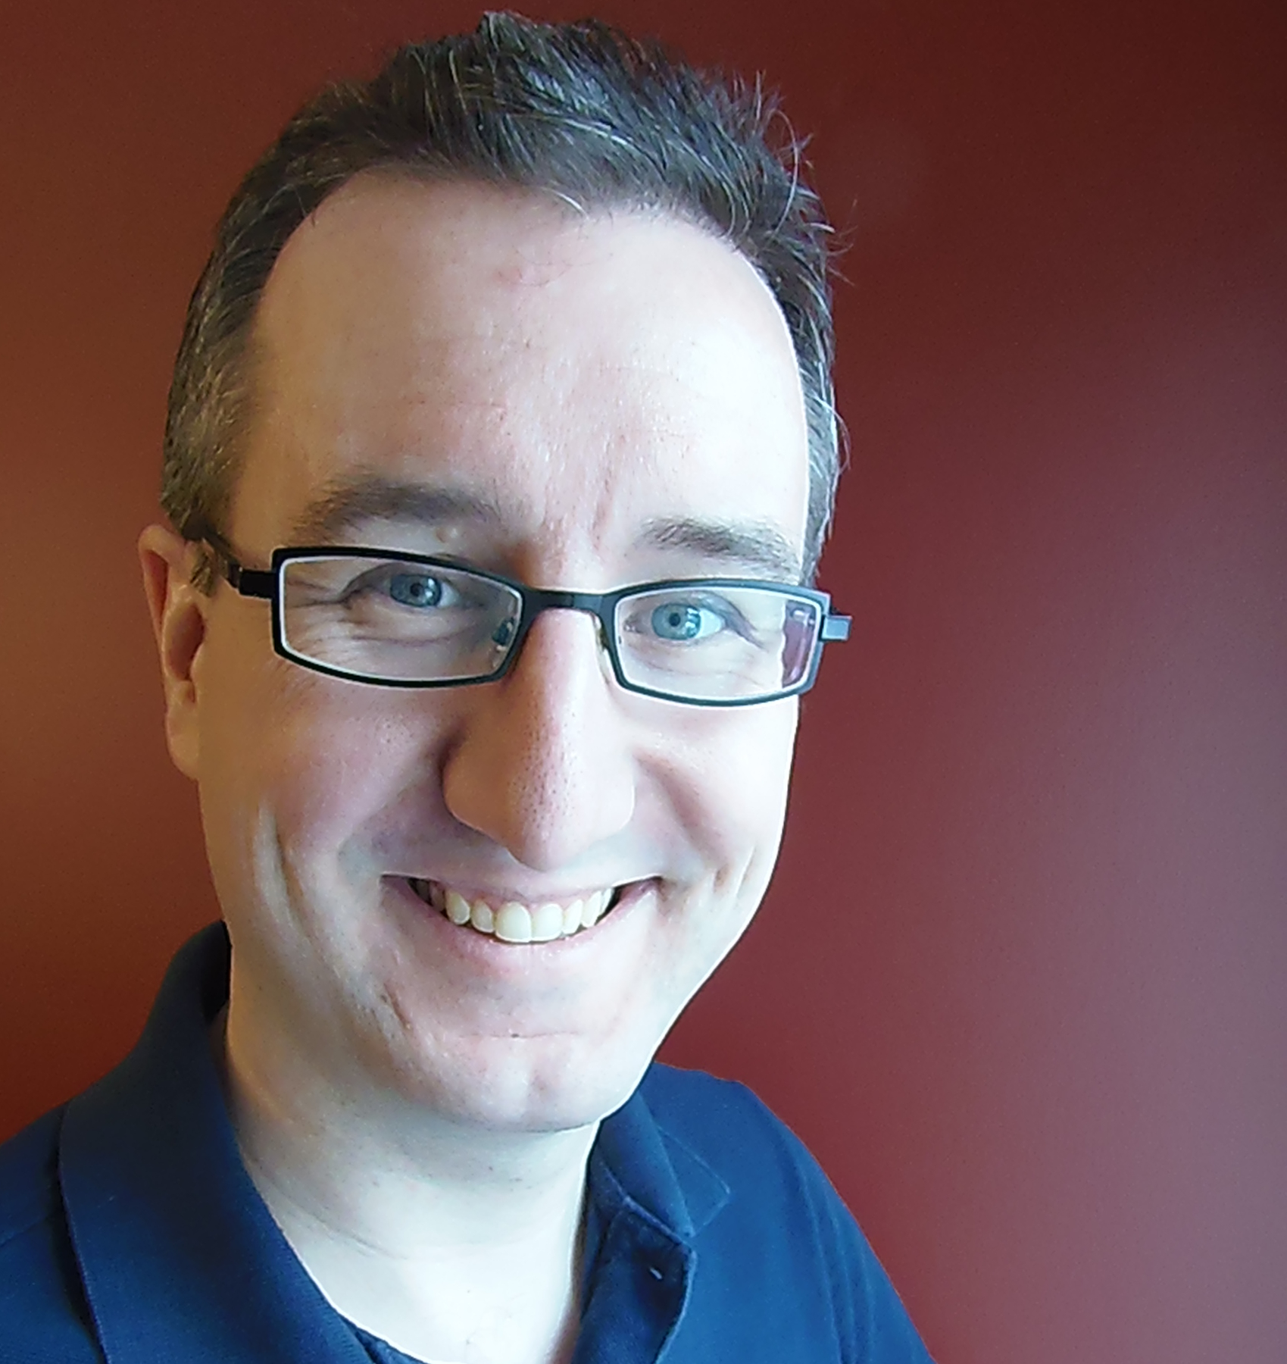
Hello, my name is Jason.
Solution Architect.
Sitecore, ALM, and DevOps
consultant.
Stopper of slapshots.
Dad.

Slide 4
01
Why is it so hard to improve?
02
Continuous Improvement
03
Build
04
Measure
05
Learn
06
Questions?
Notes:
If there are fewer items – center the agenda vertically

Slide 5
The DevOps challenge
Why is it so hard to improve?

Slide 6
Sometimes things break…
… and it was most definitely your fault.

Slide 7


Conflicting Priorities
Development
Operations

Slide 8
It’s not working…
Enhancing DevOps processes and tools across multiple teams is HARD TO DO!
Big bang solutions receive LOW ADOPTION RATES.
Planning organization-wide change TAKES TOO LONG.
We don’t know what is going to work for us!

Slide 9
“This sucks.
I can do better.”
Continuous Improvement
- Every developer ever.

Slide 10
Lean DevOps Improvement
Continuous Improvement
Lean approach: Build, Measure, Learn.
Improve processes and tools:
Processes define how we deliver software
Tools support our delivery process
IMPORTANT: Always minimize waste!

Slide 11
Where do we need to improve?
Improve processes
Improve tools
Can we better use our tools?
Did we forget someone?
Are there low-value ‘taxes’ on the teams?
What do we need to report?
What are the pain points?
Are tools reaching end-of-life?
Can teams share data?
Can we get the data needed for reporting?

Slide 12
How do we improve?
Ideas
Build
Product
Measure
Data
Learn
Identify and prioritize potential changes.
Make a change and observe the impact.
Adjust and make another change.

Slide 13
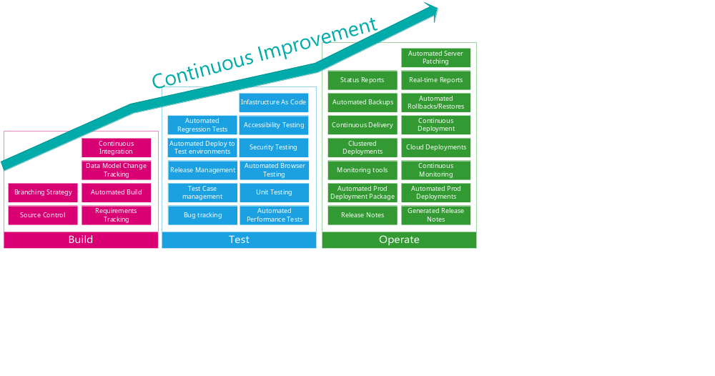
Maturity Model

Slide 14

Maturity Model Download
Get it today at: https://theagilecoder.wordpress.com/devopseast

Slide 15

How do we plan for the change?
Identify:
What is currently wrong?
Where are we trying to go?
Who will be impacted?
Are there any constraints on the changes we can make?

Slide 16
Pick and choose

Slide 17
Sample pilot plan
Making the Plan
Automated Deployments
Automated Regression Tests
Production Monitoring
Source Control
Continuous Integration
Interviews
Implement
Design
Build
DevOps Improvement Pilots
2 weeks
2 weeks
2016

Slide 18
We can do better
We have a plan, but…

Slide 19
“Predicting rain doesn’t count.
Building arks does.”
Build
- Warren Buffett

Slide 20
Implementing Improvement
Pilot all process & tool improvements with smaller team. Include everyone!
Business, Development, Test, Operations
Eliminate variables, use small incremental changes.
Give sufficient time for analysis of change.
Forming
Storming
Norming
Performing
Team tries to adopt change
Change raises challenges
Team has adapted to change
Change improves performance

Slide 21




Tools Review
Trello
www.trello.com
Atlassian JIRA
www.atlassian.net
TeamCity
www.jetbrains.com/teamcity
Visual Studio Online
www.visualstudio.com

Slide 22
We can do better
We’ve changed, but…

Slide 23
“What’s measured improves.”
MEASURE and learn
- Peter F. Drucker

Slide 24

Why do we need metrics?
Enforce a goal-oriented plan.
Analyze change over time.
Build trust through data.
Support telling your story to stakeholders.

Slide 25
A word of caution
Use metrics for process evaluation.
Not employee evaluation.

Slide 26


Reporting on Progress
Produce a bar chart.
Red/Green/Yellow status against plan.
Wow. This sounds boring.
When does this meeting end?

Slide 27
Reporting on Success
Gather data and report at regular intervals.
Focus on:
What did we change?
What did we learn?
The only failure is not doing something.

Slide 28
4 metrics for measuring success
Mean Time to Recover (MTTR)
Impact: Short and rapid path for fixes to production.
Lead time
Impact: Smaller batches and optimized requirements and testing processes.
Deployment Success Percentage
Projects Completed per Quarter
Impact: Smaller low-risk changes deployed more often.
Impact: Processes support smaller, parallel projects.

Slide 29
What do the metrics tell us?
Delivery improved?
Delivery degraded?
Was the cost too high?
Keep change but introduce refinements to lower cost, address Deltas from retrospective.
Were there any Plus results in the retrospective?
Remove the change and introduce a new change that preserves positive aspects.

Slide 30
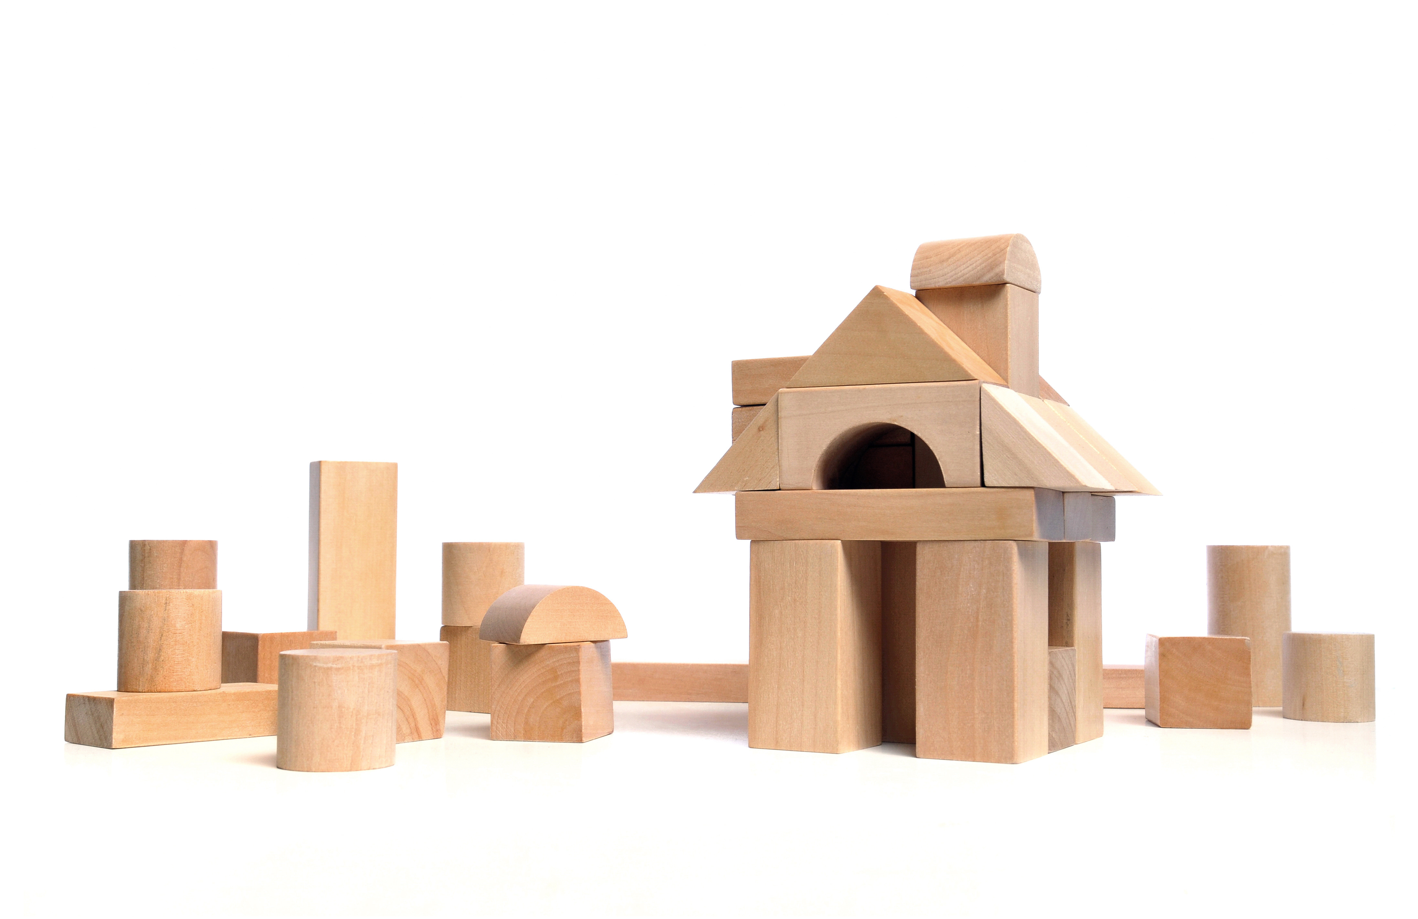
Continue Improving!
Ideas
Build
Product
Measure
Data
Learn

Slide 31


Jason St-Cyr jst-cyr@nonlinear.ca
THANK YOU
Questions?
@AgileStCyr
theagilecoder.wordpress.com

Slide 32
Remember
We can do better.

